Slide 1

supermus.be
watch & learn
LP 55-250 kW 5 Bar
Structure E-learning (part 01-02)
03/2020
user-oriented digital training
video • animation • serious games

Slide 2
About this presentation
This is about structure – not design.
For example: the coach is represented by a standard icon, the map of China is still a stock image …
Current status:
- Content has been analyzed and flow through training has been defined, so that all content is covered.
- Introduction, the market -> interactive version is available
Required information from Atlas Copco
-> what ”advanced” info can be left out?
-> details about applications (slide 9)
-> technology (slide 10) -> should we add something here?
Live demo:
www.cirquetechnique.com
Password: con2019 and select the machine to launch the latest version.
LP 55-250kW 5 Bar – Structure E-learning

Slide 3
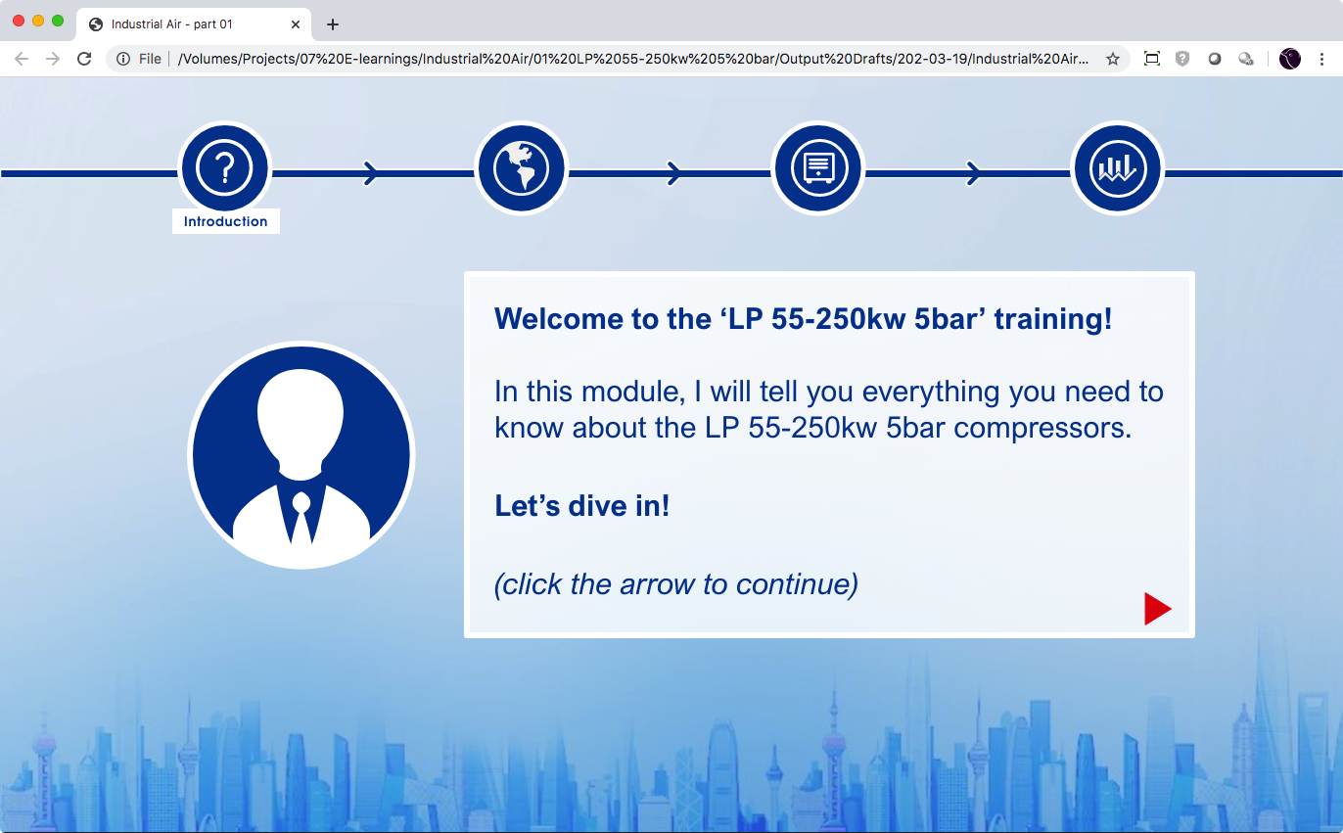
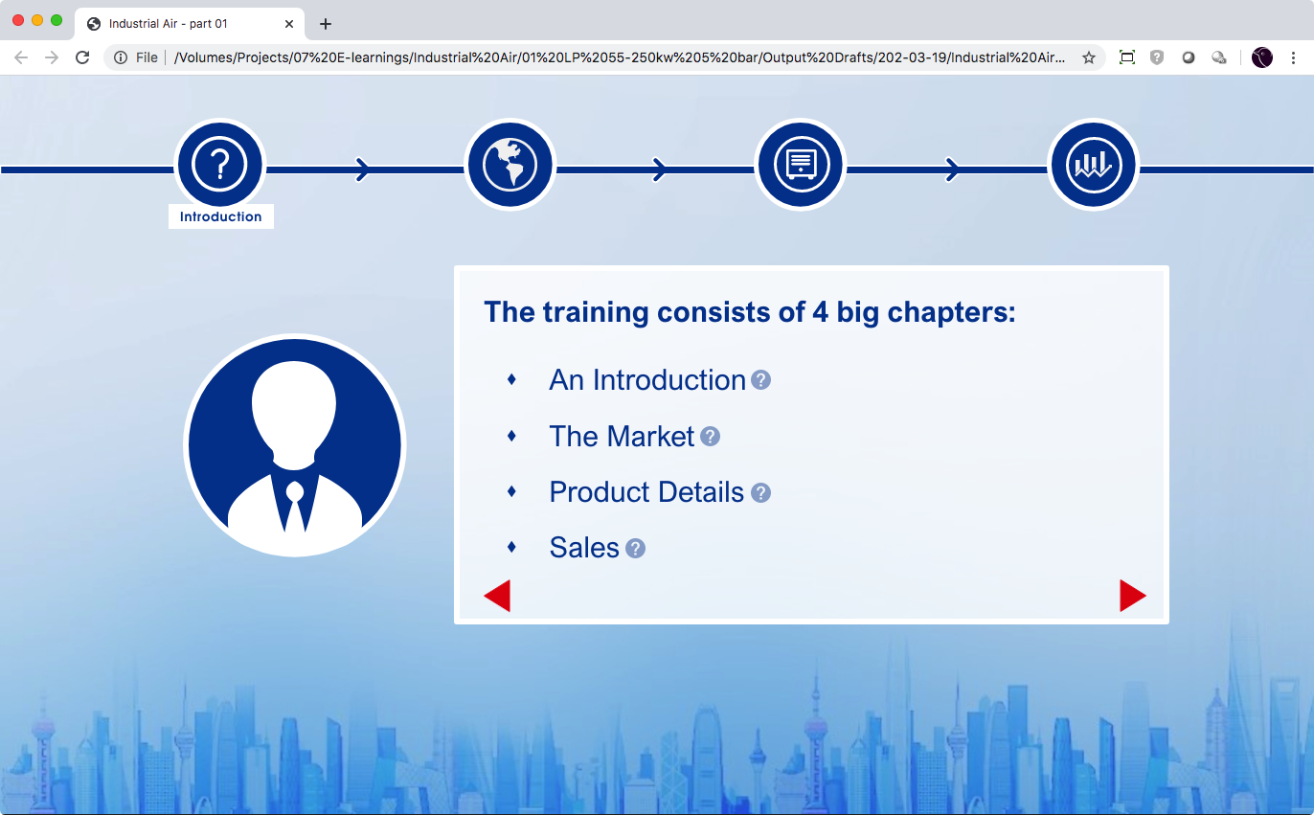
4 Chapters
We define 4 chapters,
Click ”?” to get more information about what to expect.
Introduction: a quick introduction to get to know the compressors this training is about.
The Market: who are the potential customers for these compressors and in which industries and regions to find them.
Product details: a detailed view of the compressors’ features, their Customer Benefits and their installation options.
Sales: all information you learned in the previous chapters comes together. Your knowledge will be put to the test!
The reason behind this is:
With the introduction, the learner gets a general idea of the new machine; this helps in the market chapter.
In the market we define the current market and the opportunities – and where the new machine fits in.
Then we dive deeper into the advantages of the new machine.
When the product and the market is known, it is time to learn how to make the sale by combining what’s been learned in the two other sections.
About these round-up pages
Between every chapter, we will display this “summary”, where the coach (to be designed) rounds up the key takeaways from the previous chapter and tell what to expect in the next.
About the chapters
Every chapter will have a similar structure:
The learner is guided through information
The learner can explore similar information on his own.
A test is taken at the end of the chapter. The user can go back to the information to look op information he might have missed.
LP 55-250kW 5 Bar – Structure E-learning

Slide 4
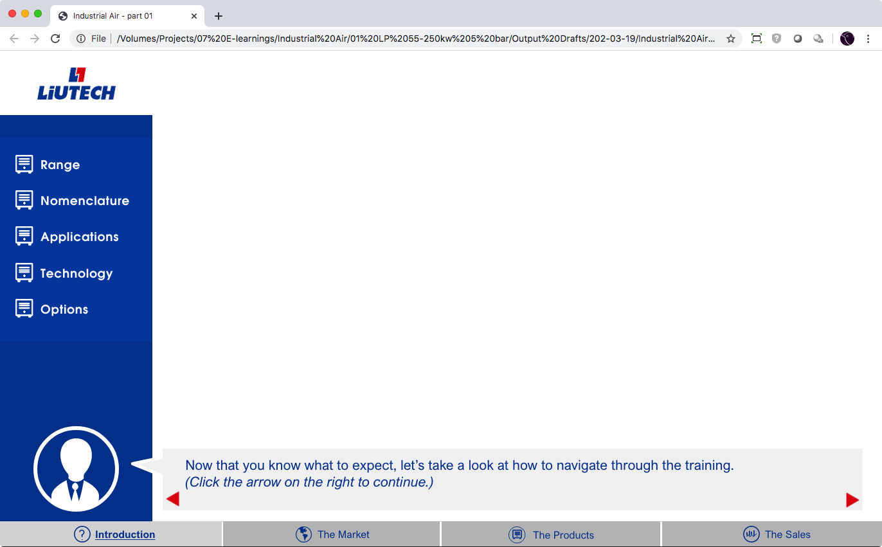
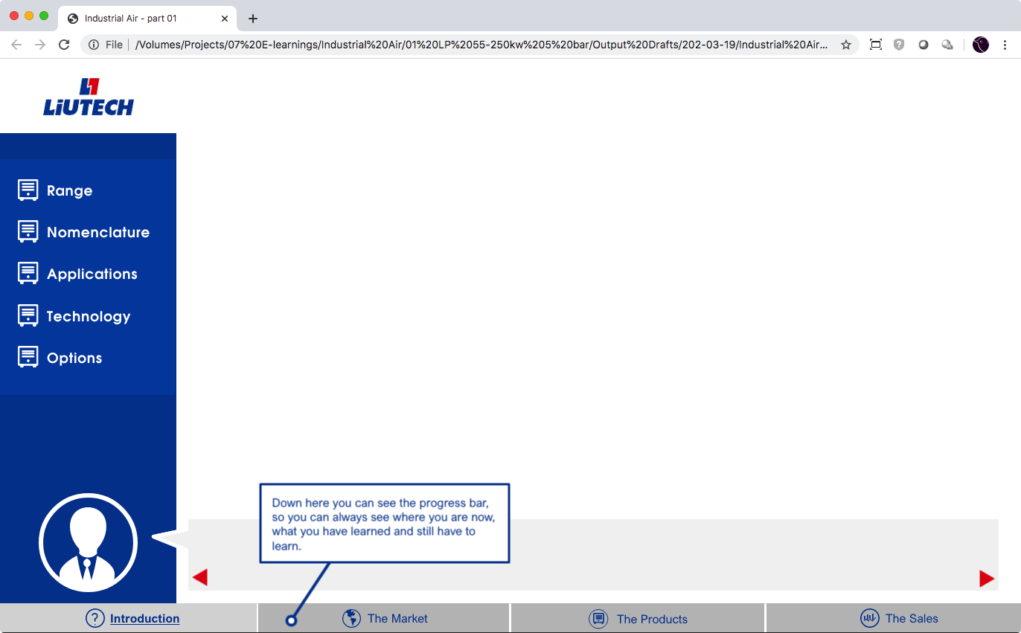
Explaining the training concept
In a few steps, we show the user how the training is built up. To avoid any confusion.
The main navigations are:
Dialog boxes by a coach – this will make it more personal (coach to be designed)
An overview of the chapters and the progress is shown in the bottom bar
Side menu to navigate inside a chapter
LP 55-250kW 5 Bar – Structure E-learning

Slide 5
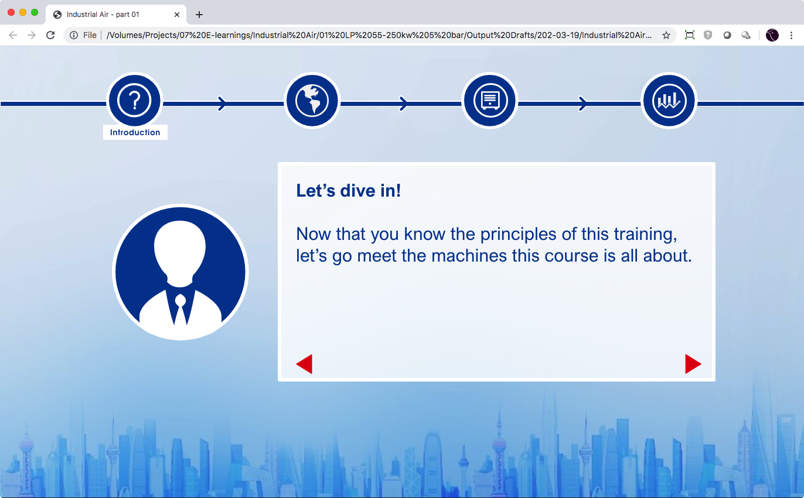
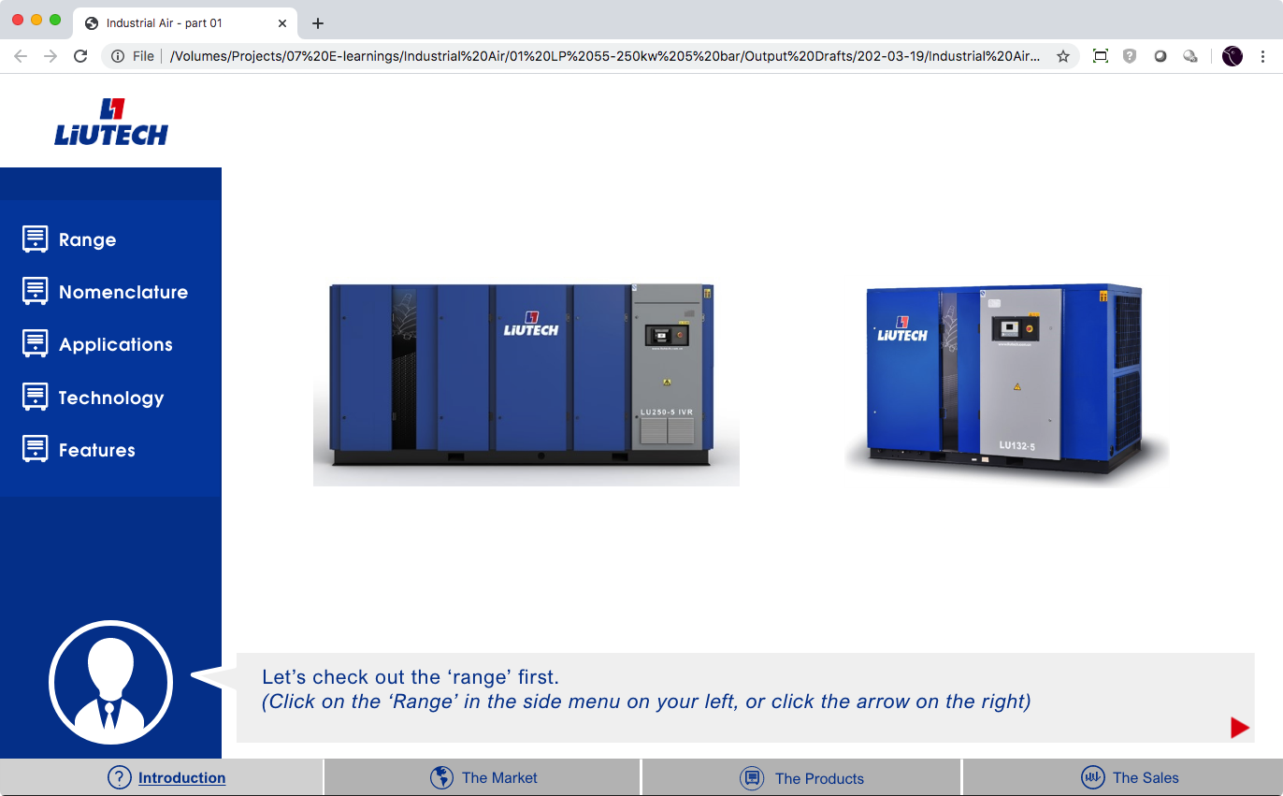
Range
The first part (Range) of this chapter is guided by the coach.
The other parts will be free to navigate through, after the range section is completed.
LP 55-250kW 5 Bar – Structure E-learning

Slide 6
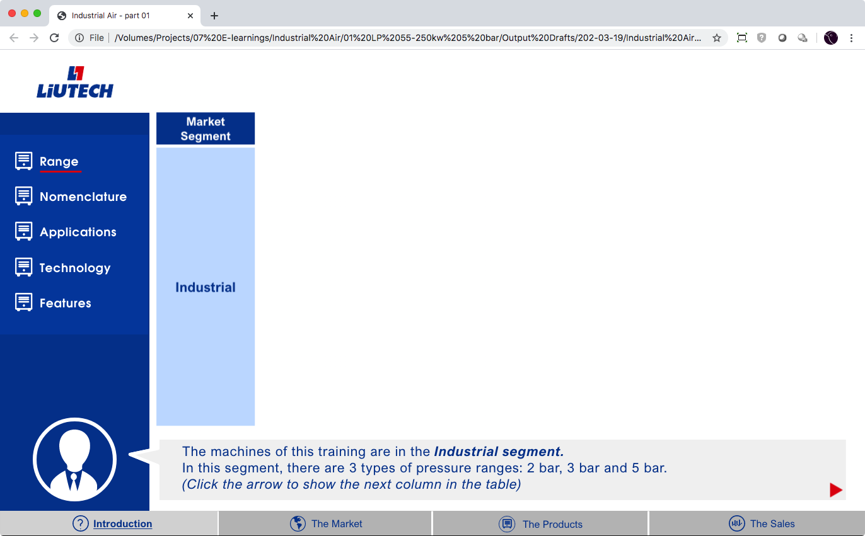
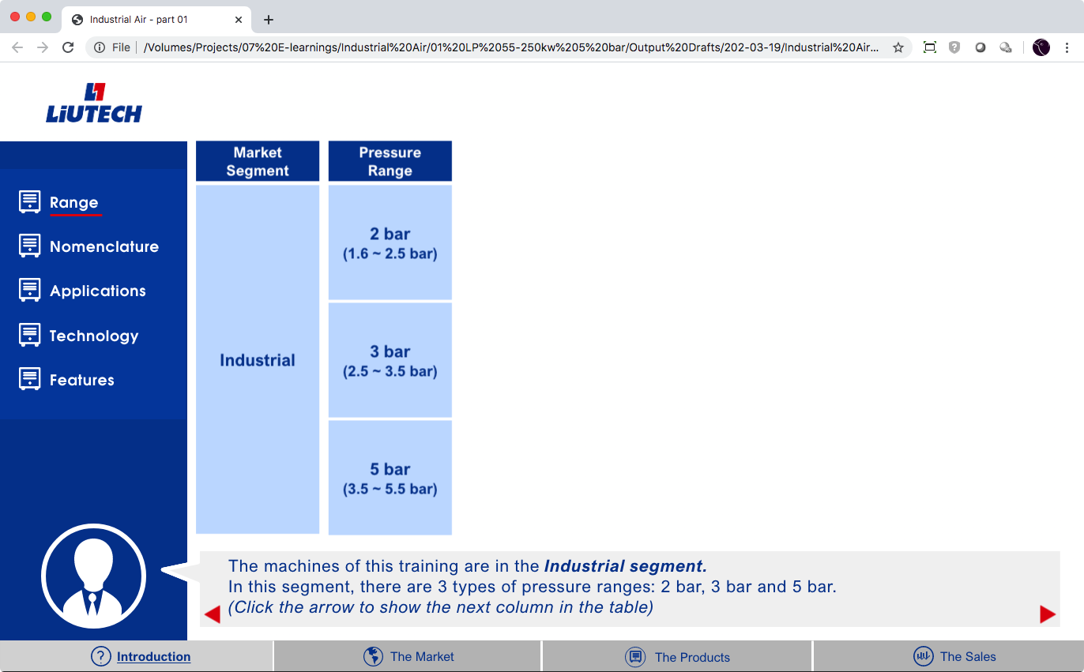
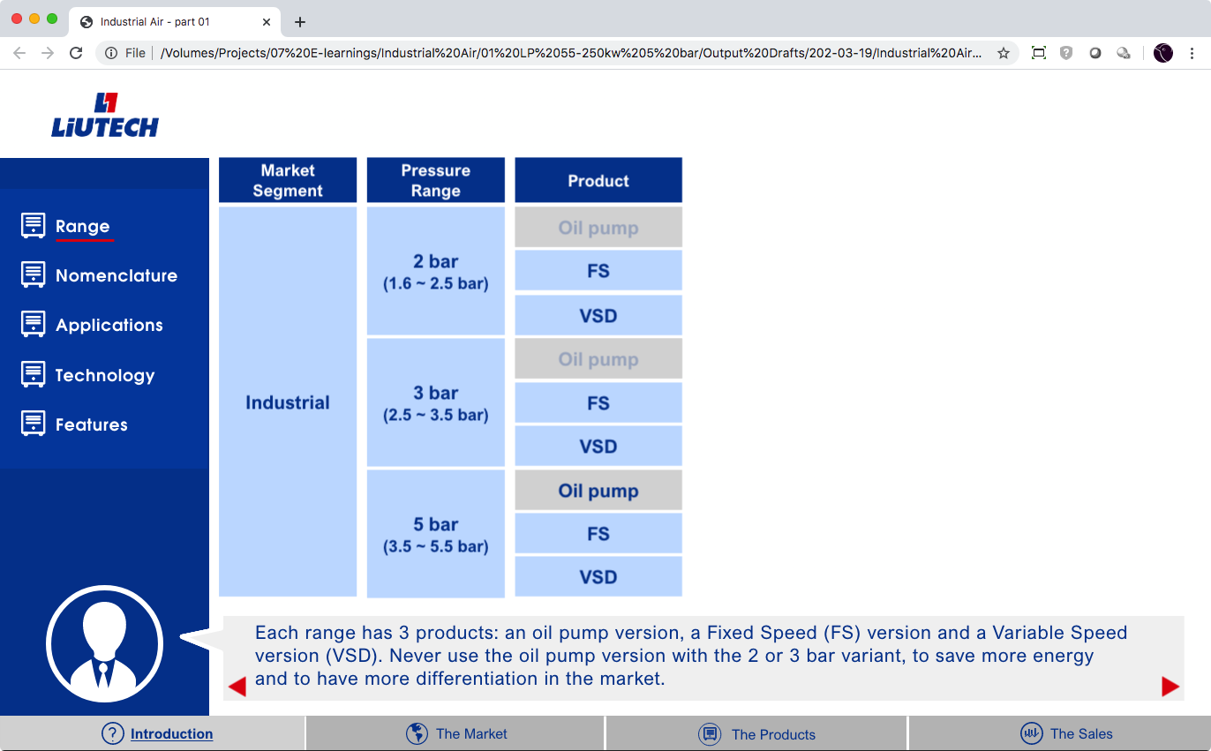
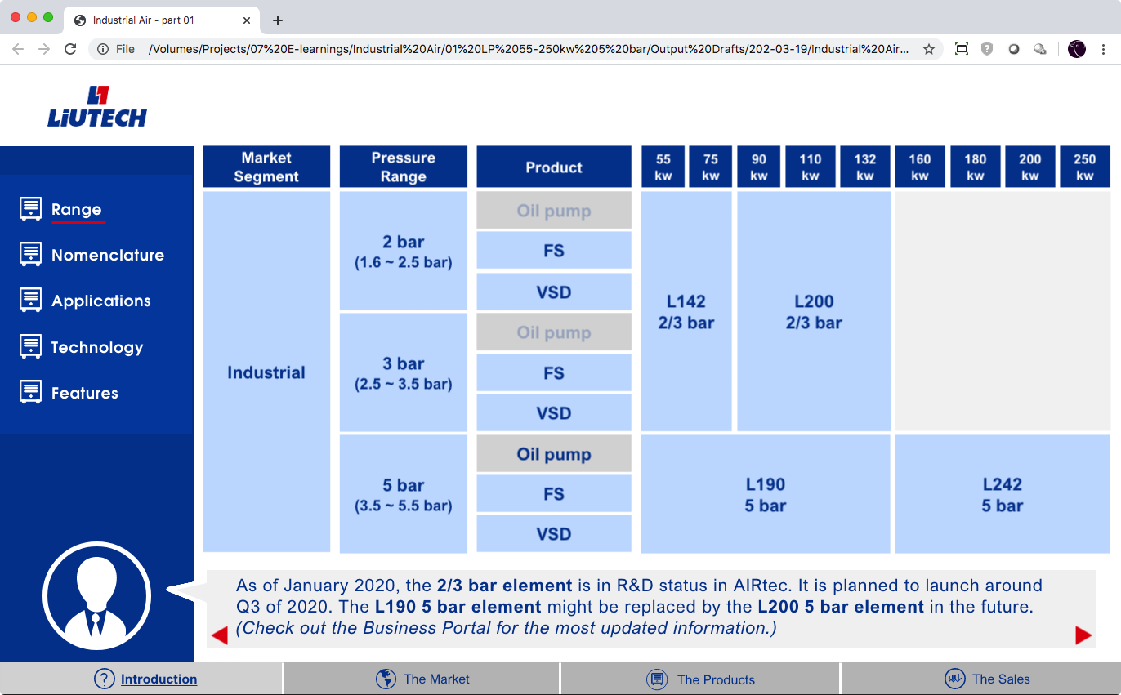
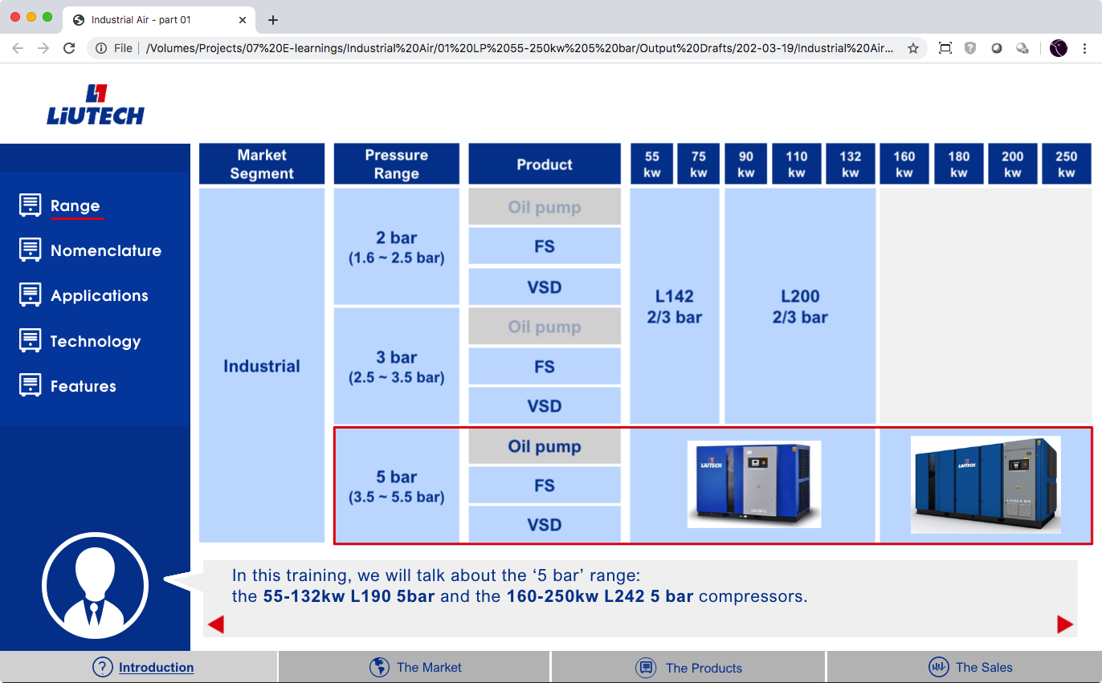
Range
The table of pressure ranges, will be built up, step by step.
The coach explains every step.
LP 55-250kW 5 Bar – Structure E-learning

Slide 7
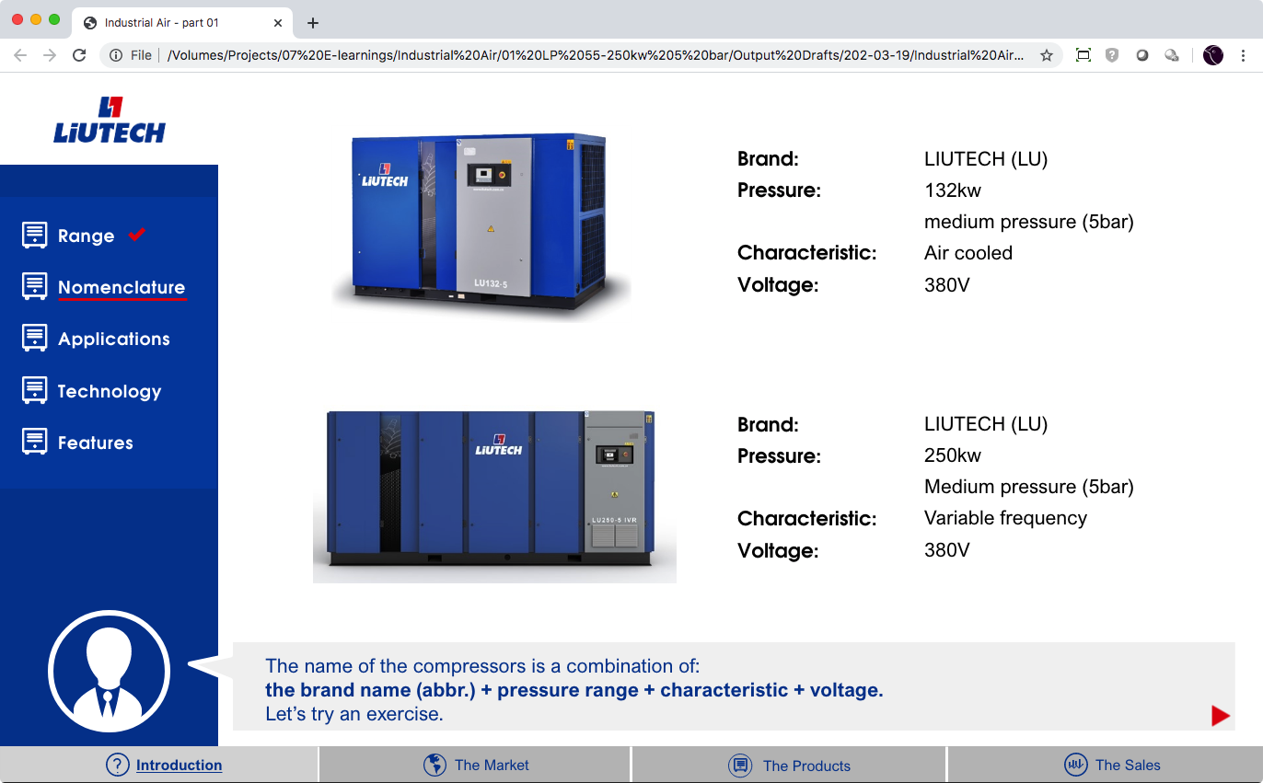
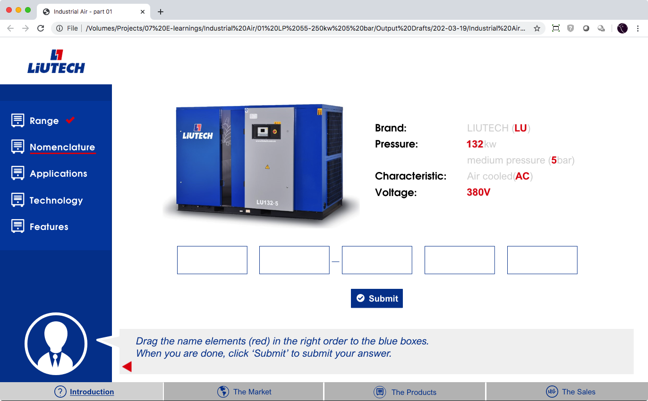
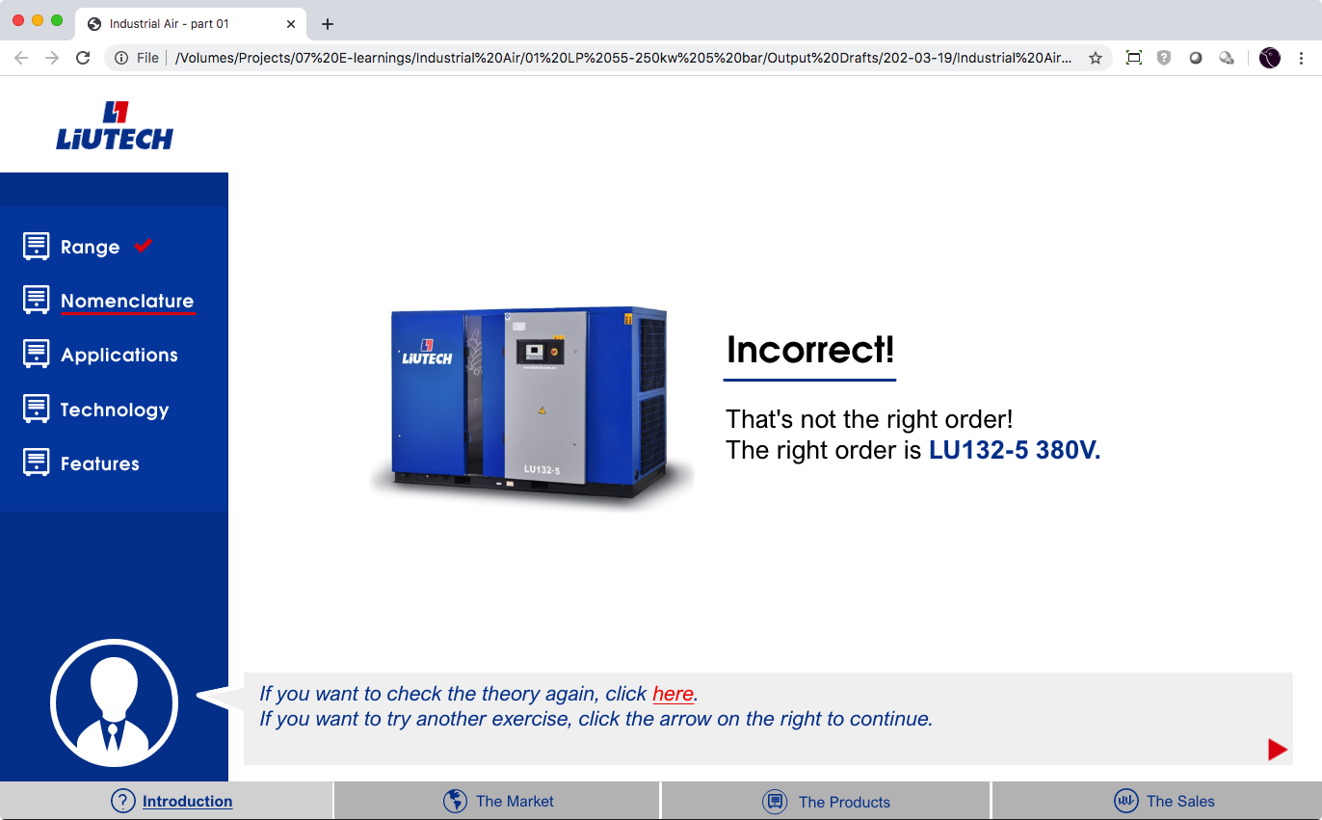
Nomenclature
In the first step, the nomenclature is explained.
In the second step 2 exercises (drag and drop) are presented.
It is always possible to go back to the first slide and learn how it should be done.
LP 55-250kW 5 Bar – Structure E-learning

Slide 8
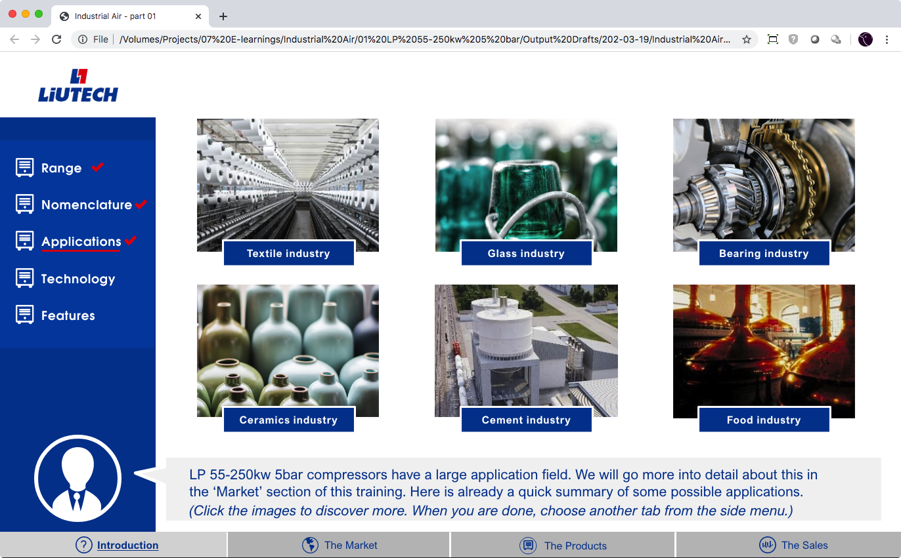
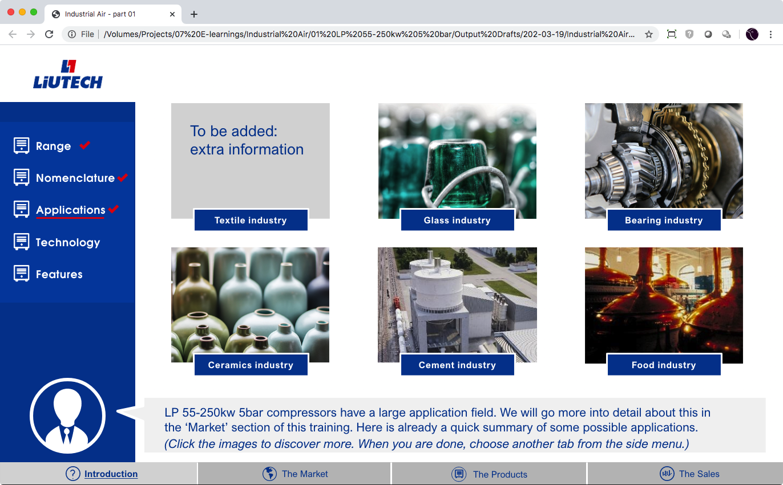
Applications
As this is only the introduction, we are not going to deep into details about the applications. This is repeated in the market sections.
However, we want to show it here already, as repetition is an important learning factor.
The user can click a picture, it flips, and a little background information is shown.
This info needs to be supplied by Atlas Copco
The same animation principle will be used in the market section.
LP 55-250kW 5 Bar – Structure E-learning

Slide 9
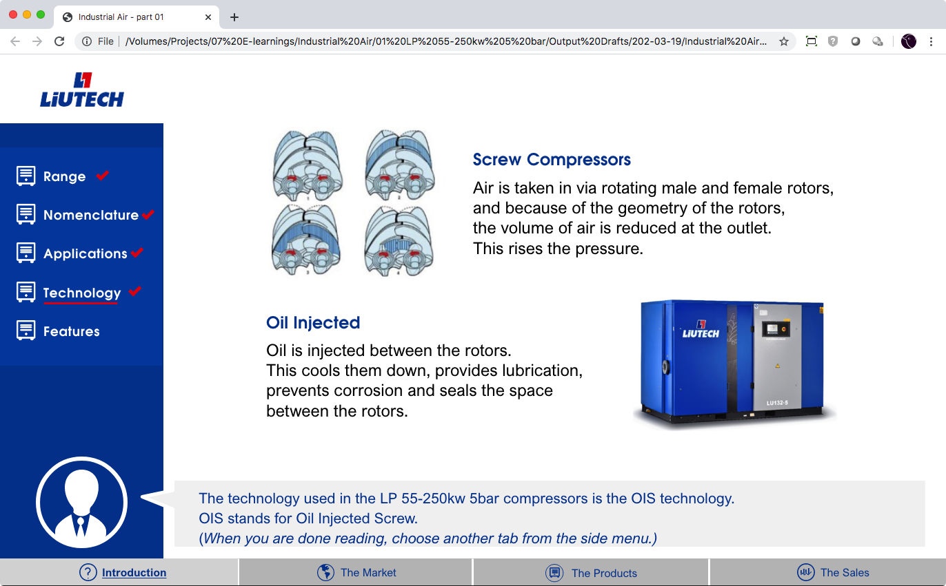
Technology
This is a very brief information slide, just saying that it is an oil injected screw compressor. Maybe this can be extended with more information – to be defined by Atlas Copco.
LP 55-250kW 5 Bar – Structure E-learning

Slide 10
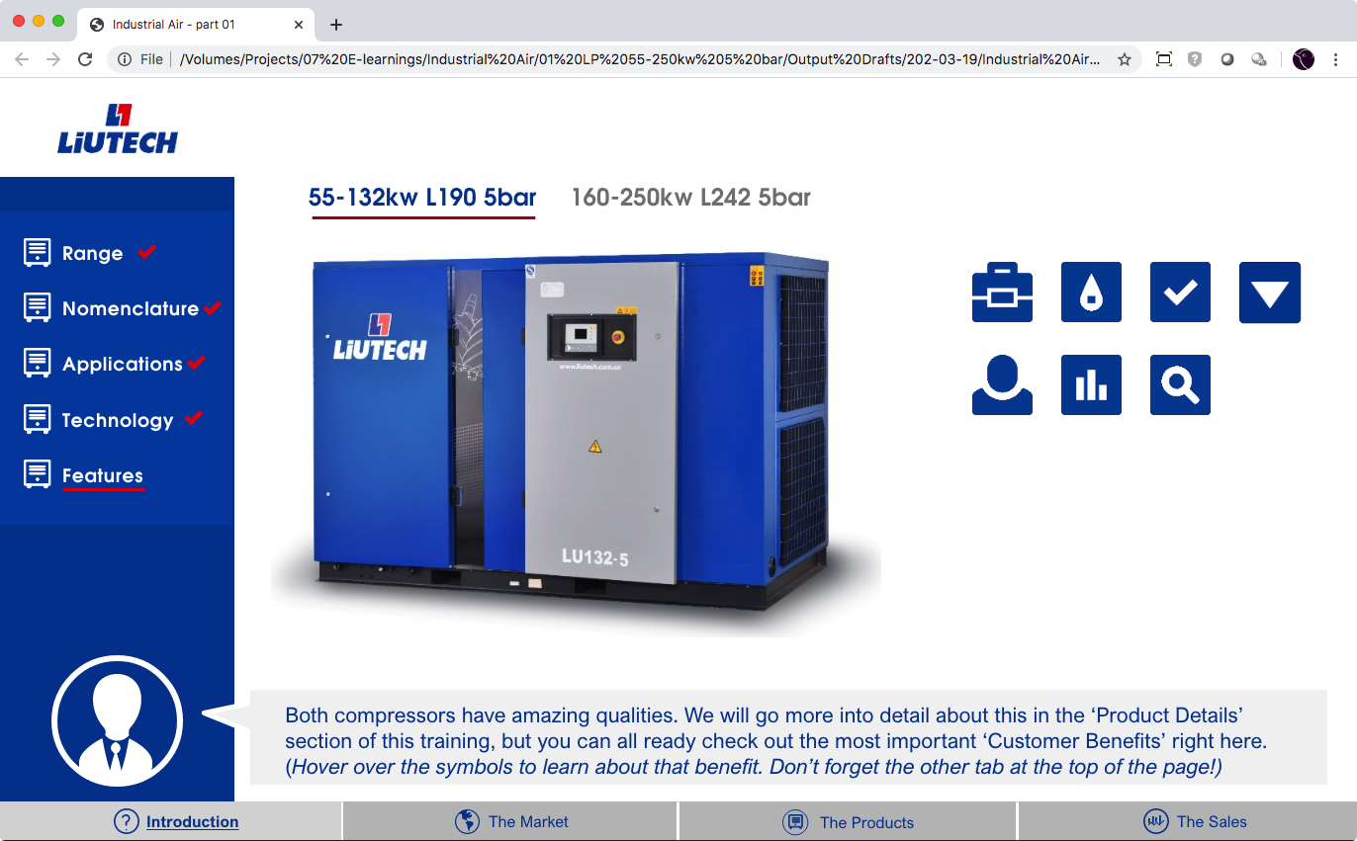
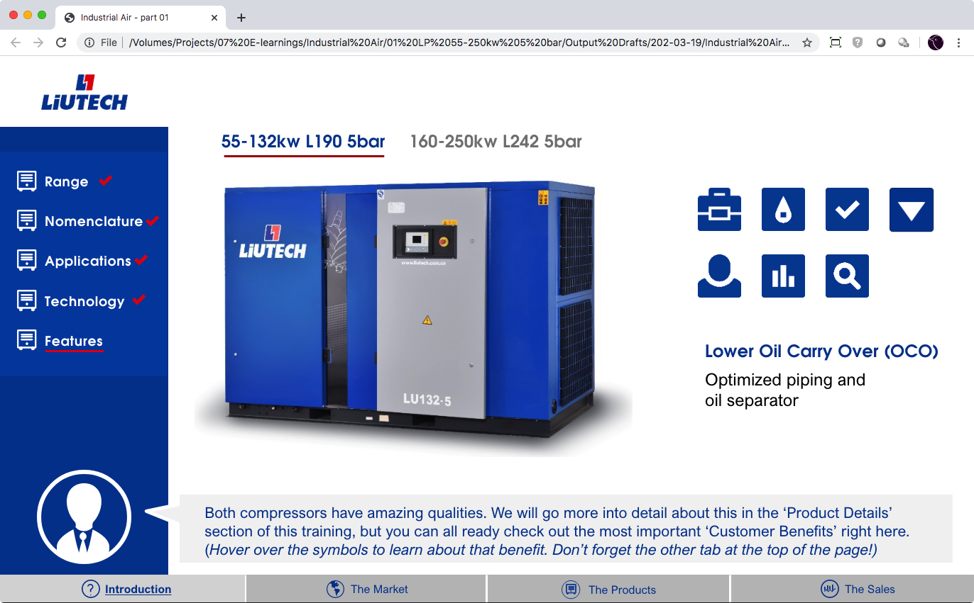
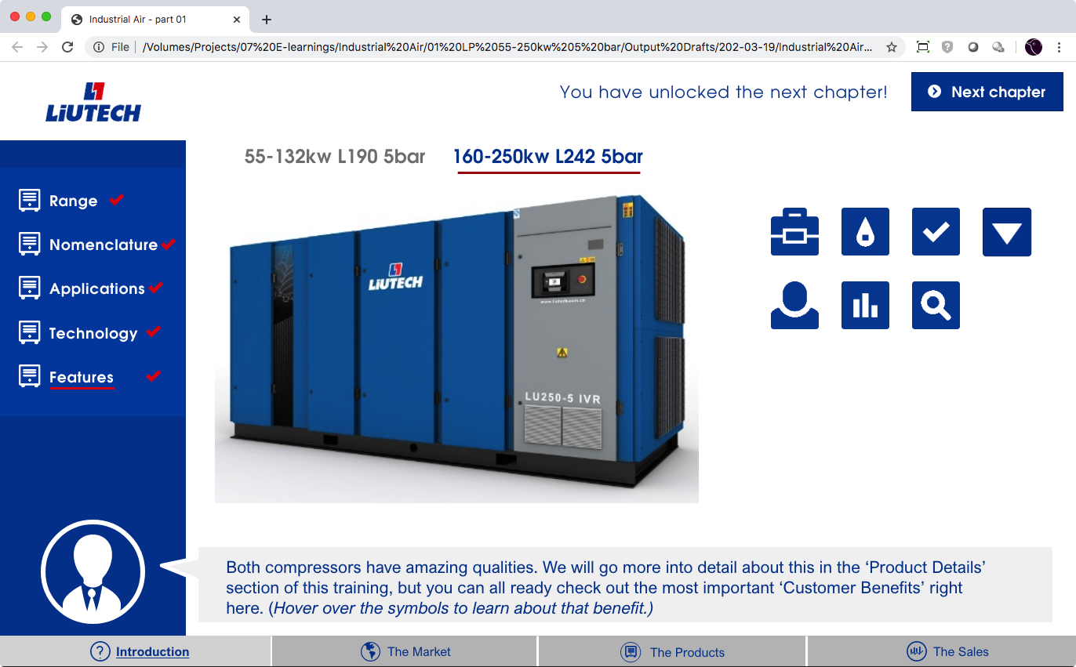
Features
This is a preview of the 3rd topic “The Products”, again, already shown because of the repetition.
The user can hover over the icons and learn what the features of the units are.
Once both ranges have been explored, a “you have unlocked …” message appears.
LP 55-250kW 5 Bar – Structure E-learning

Slide 11
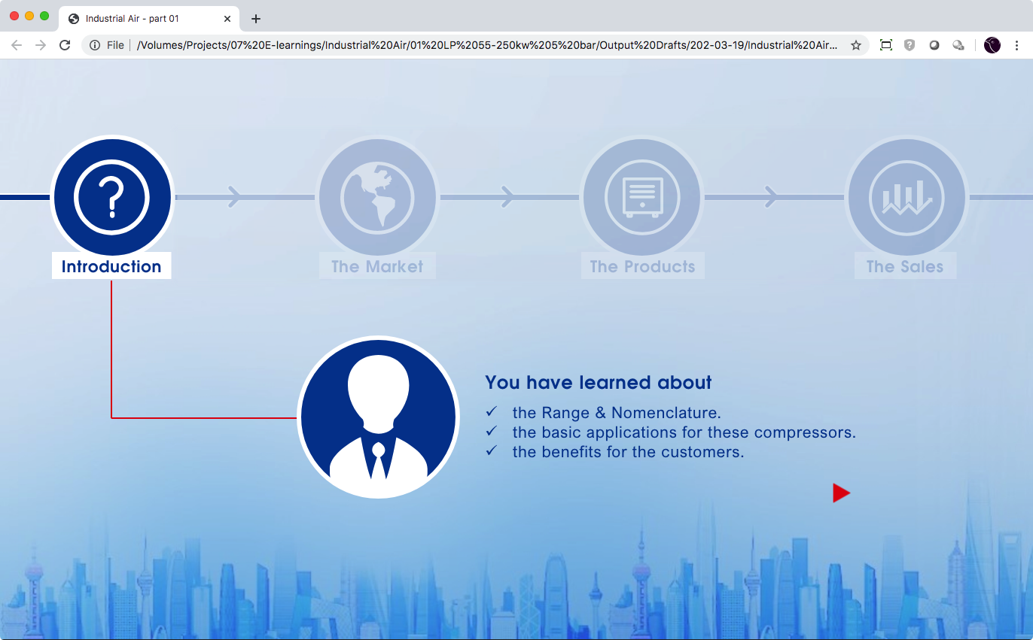
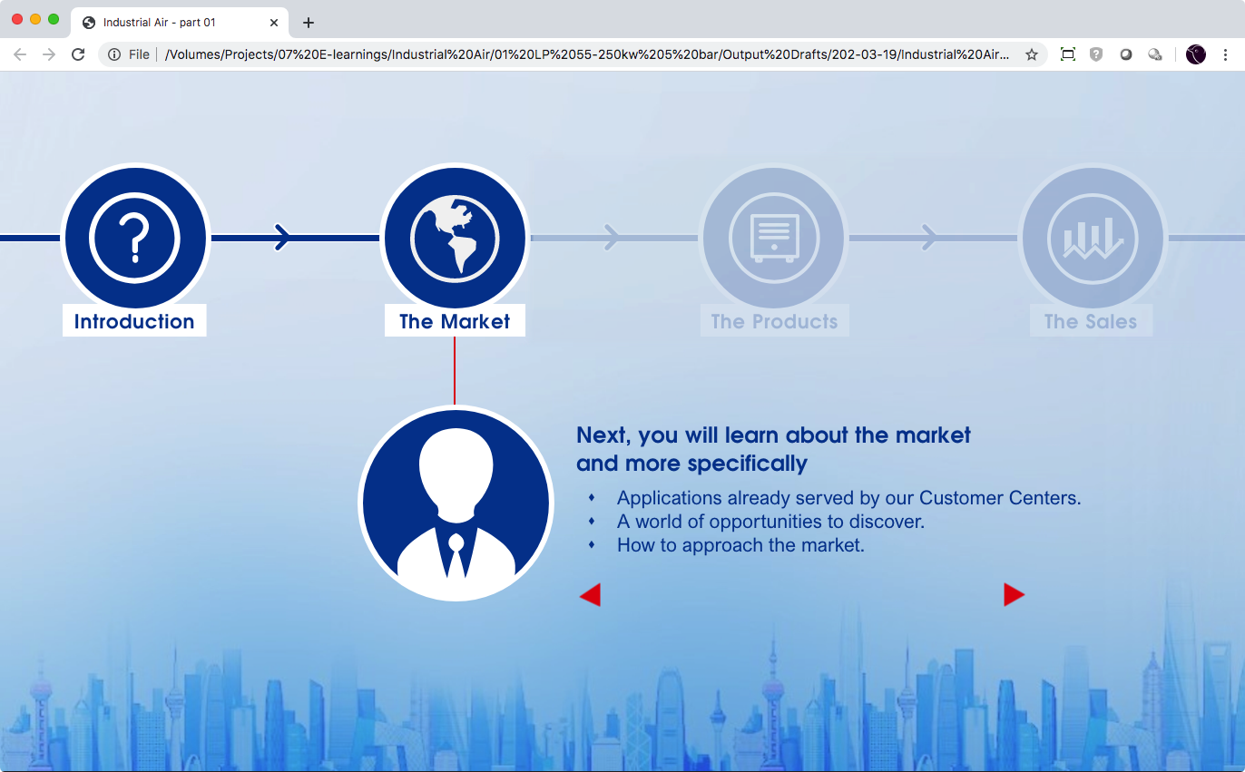
Round up
Since the previous chapter was only the introduction, there is not yet a test.
LP 55-250kW 5 Bar – Structure E-learning

Slide 12
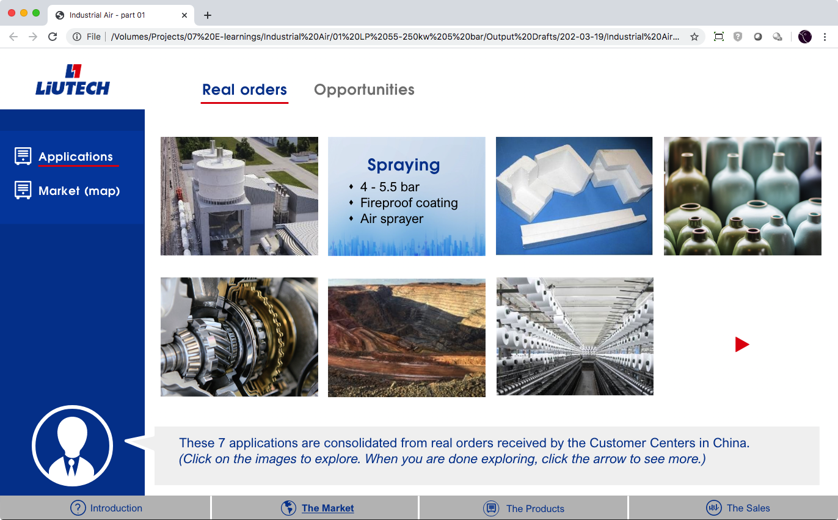
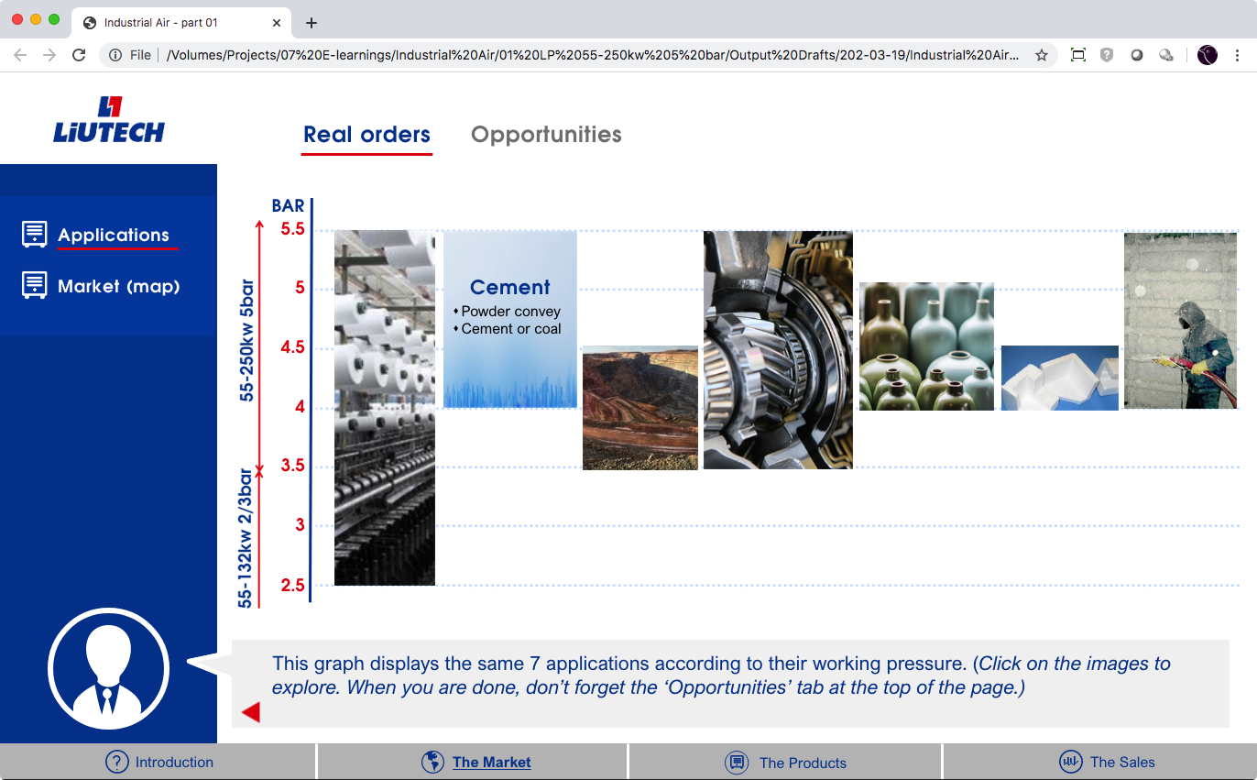
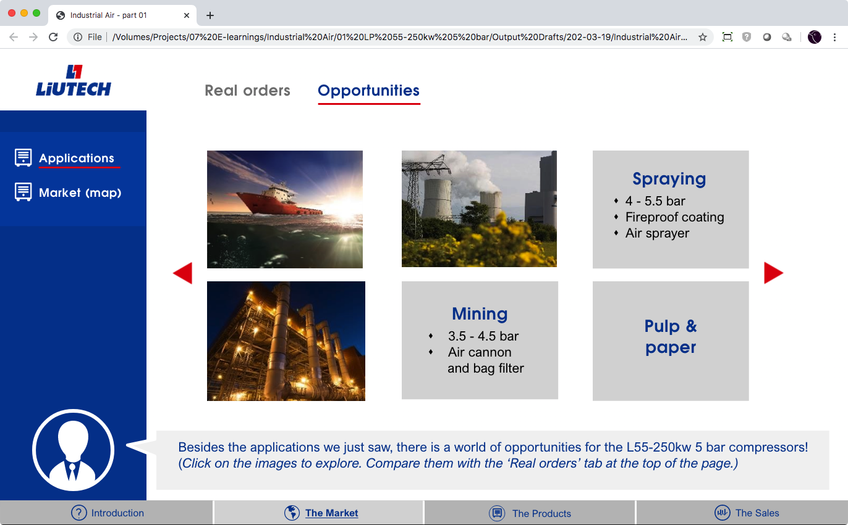
Real orders vs opportunities
First, we explore applications, based on real orders.
Users can click the images to read the details.
Secondly, we stress that there is a world of opportunities.
Applications vs market
Once we know the applications and the world of opportunities, we can explore the market.
LP 55-250kW 5 Bar – Structure E-learning

Slide 13
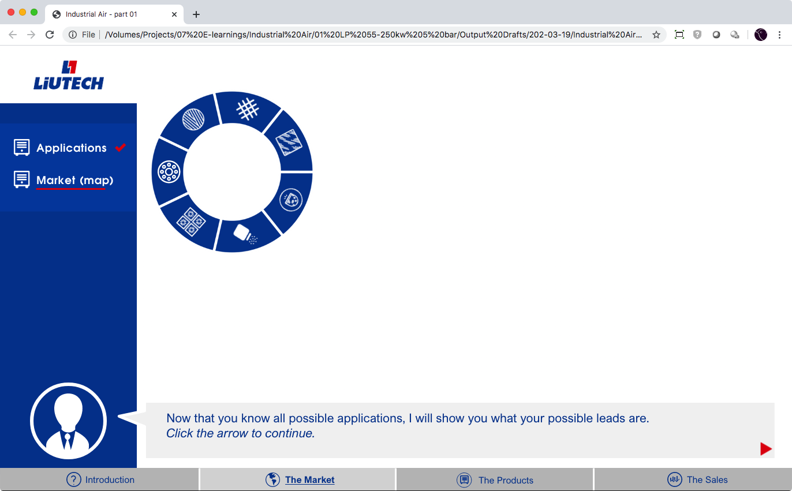
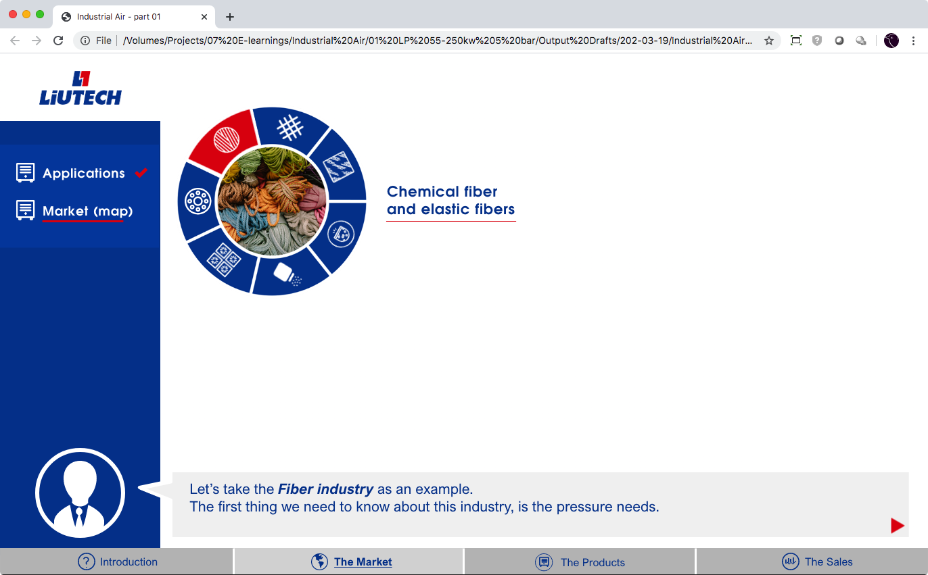
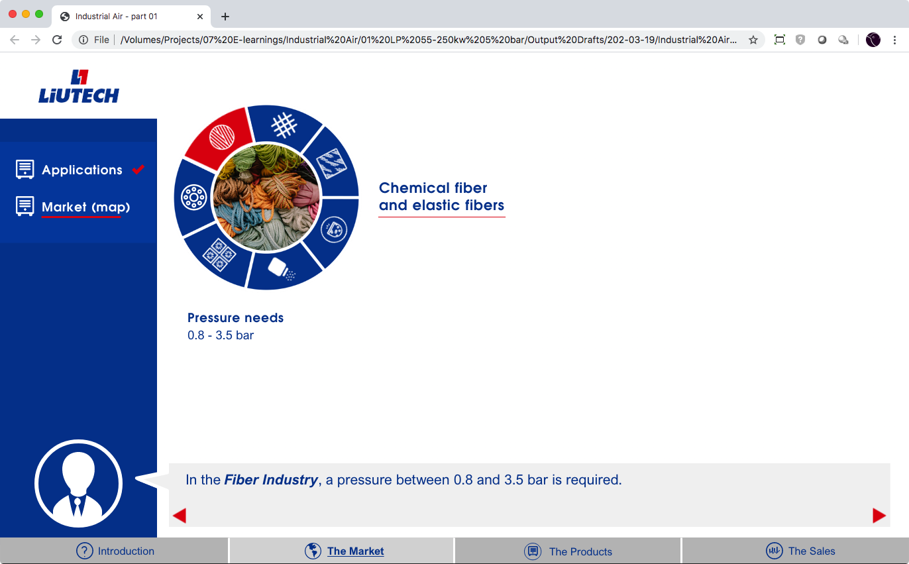
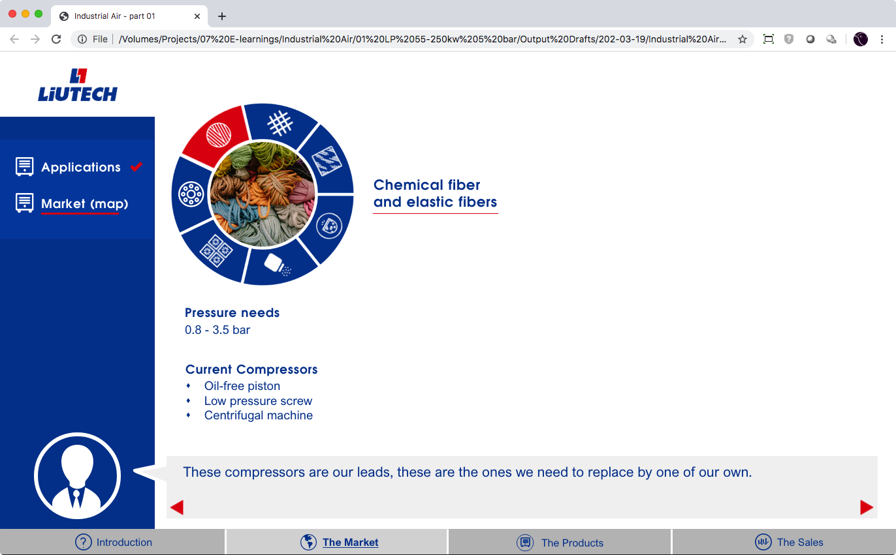
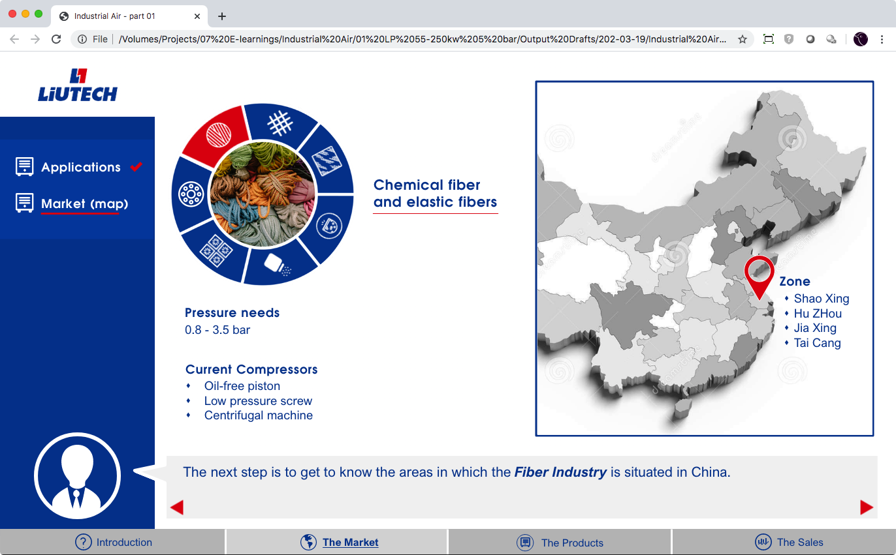
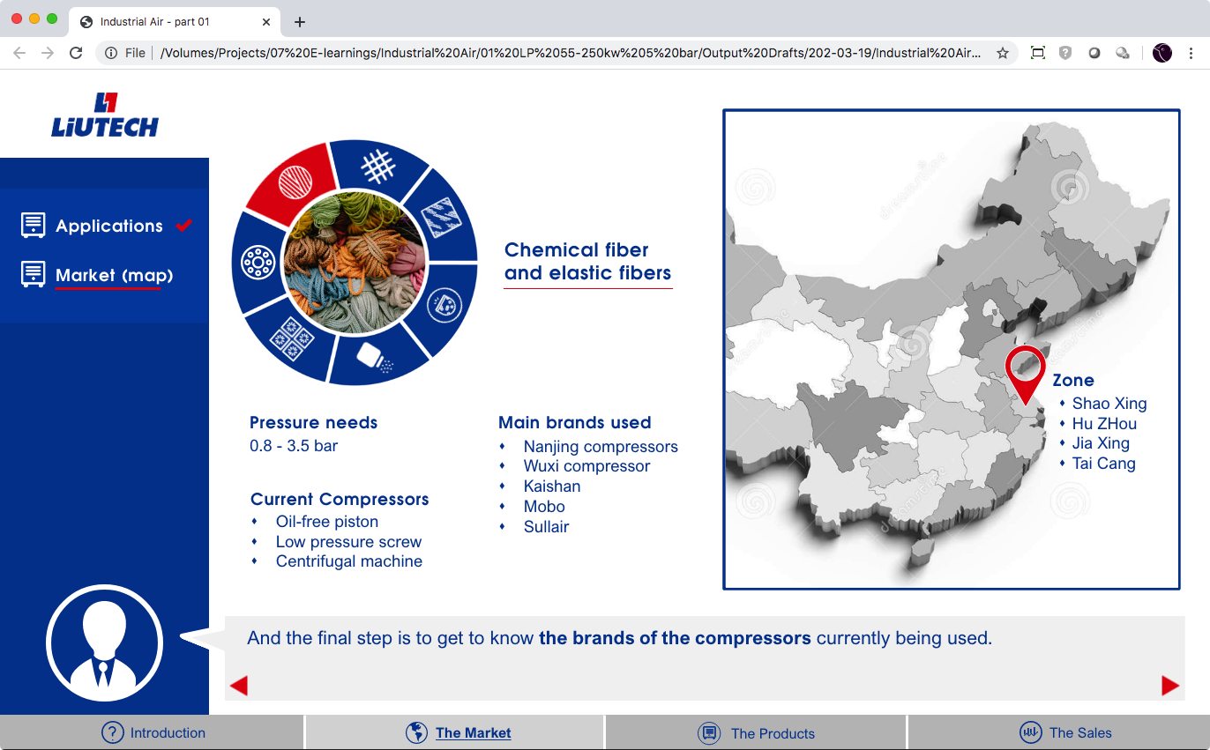
Guided exploration of the market
In a first example, the coach guides the learner through the details of one market.
LP 55-250kW 5 Bar – Structure E-learning

Slide 14
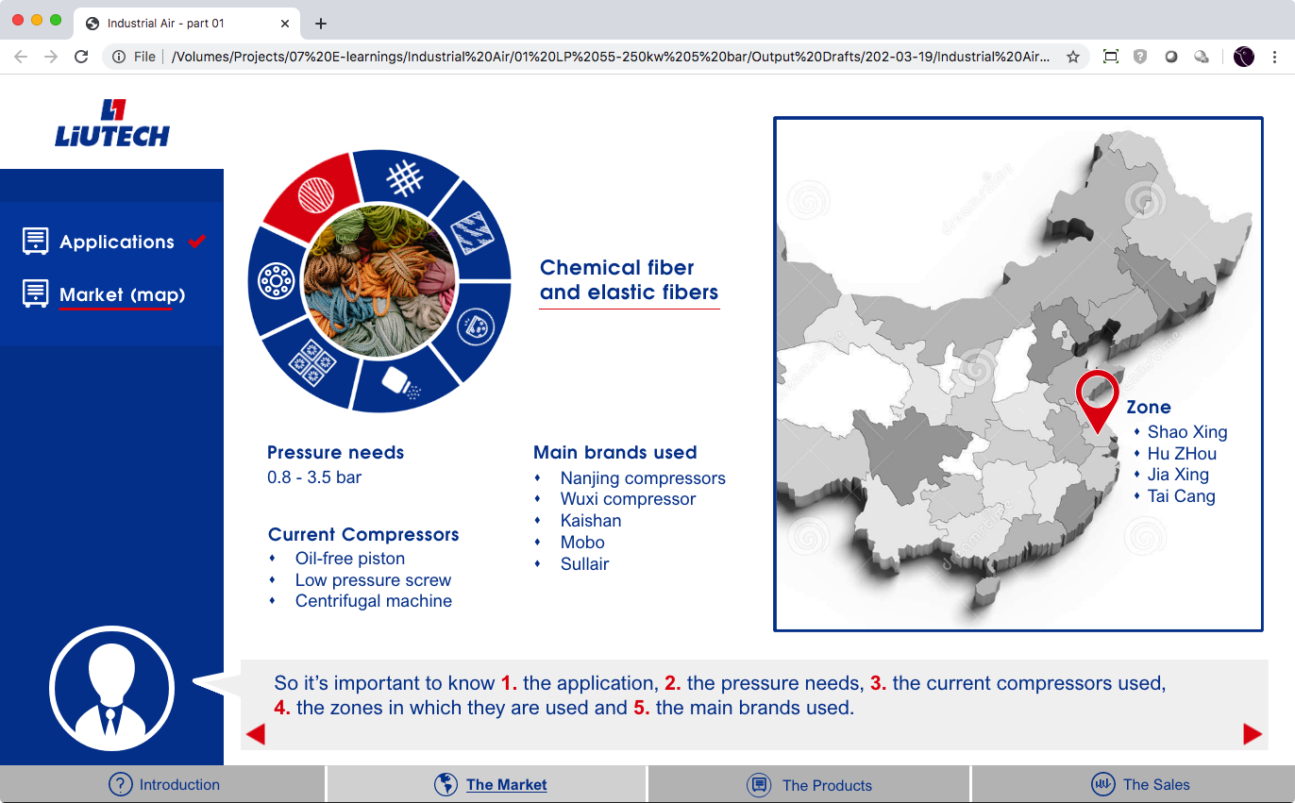
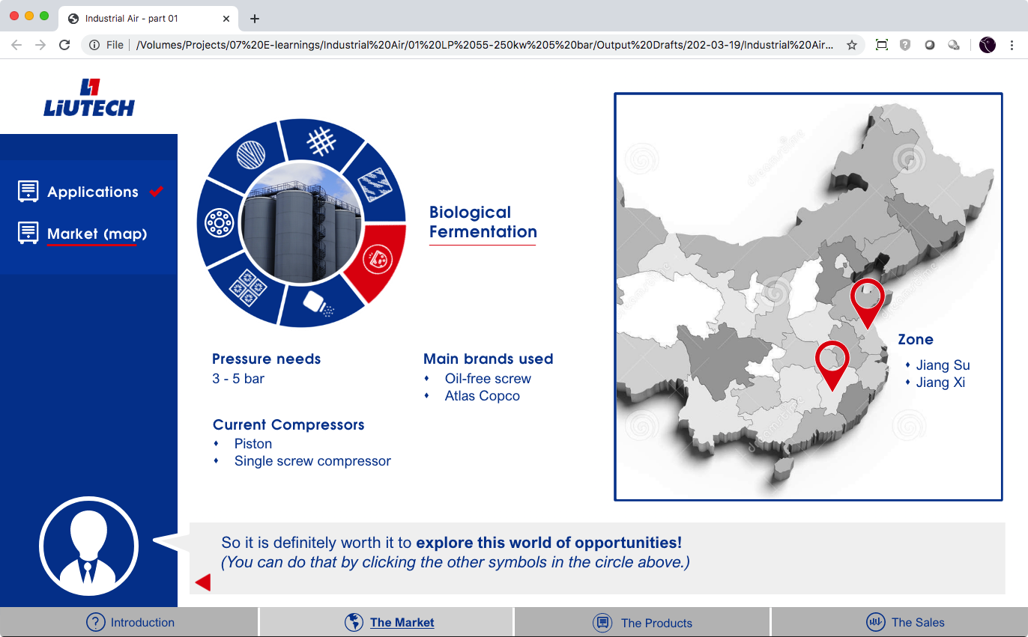
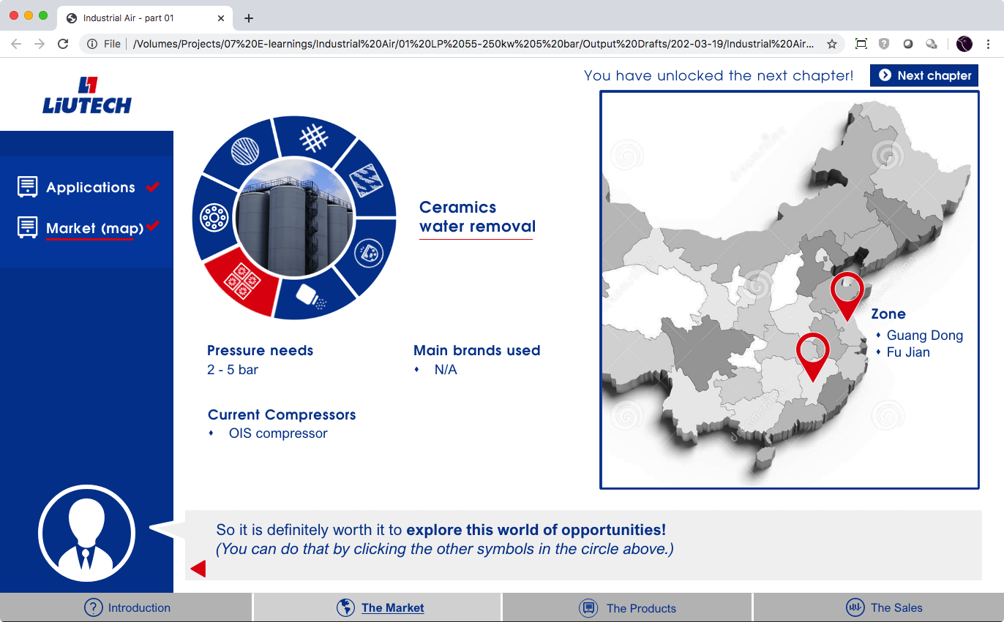
Free exploration of the market
After a summary, the user can explore the other industries on his own.
When done … an ”unlocked” message appears, and the user can go to the next chapter.
LP 55-250kW 5 Bar – Structure E-learning

Slide 15
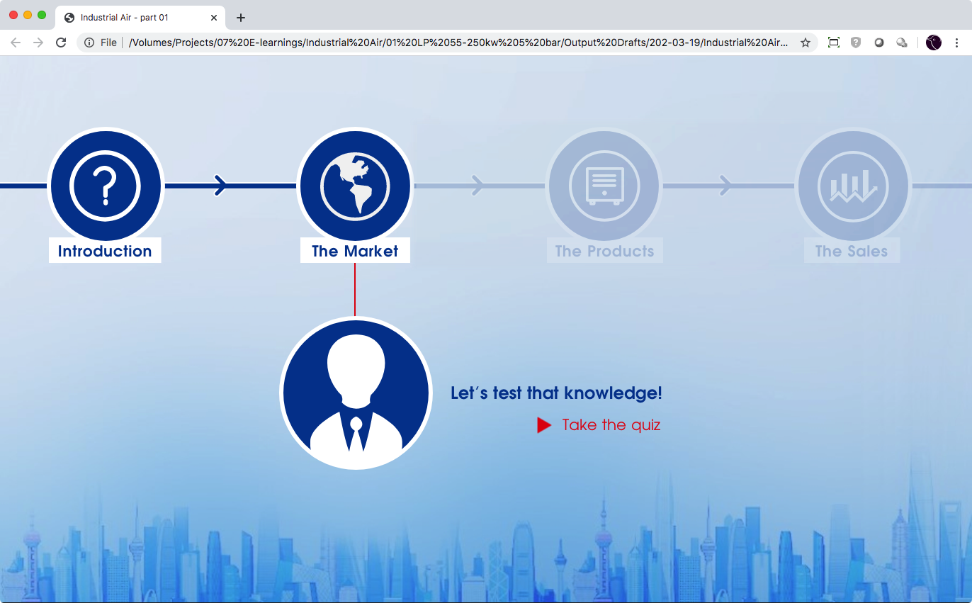
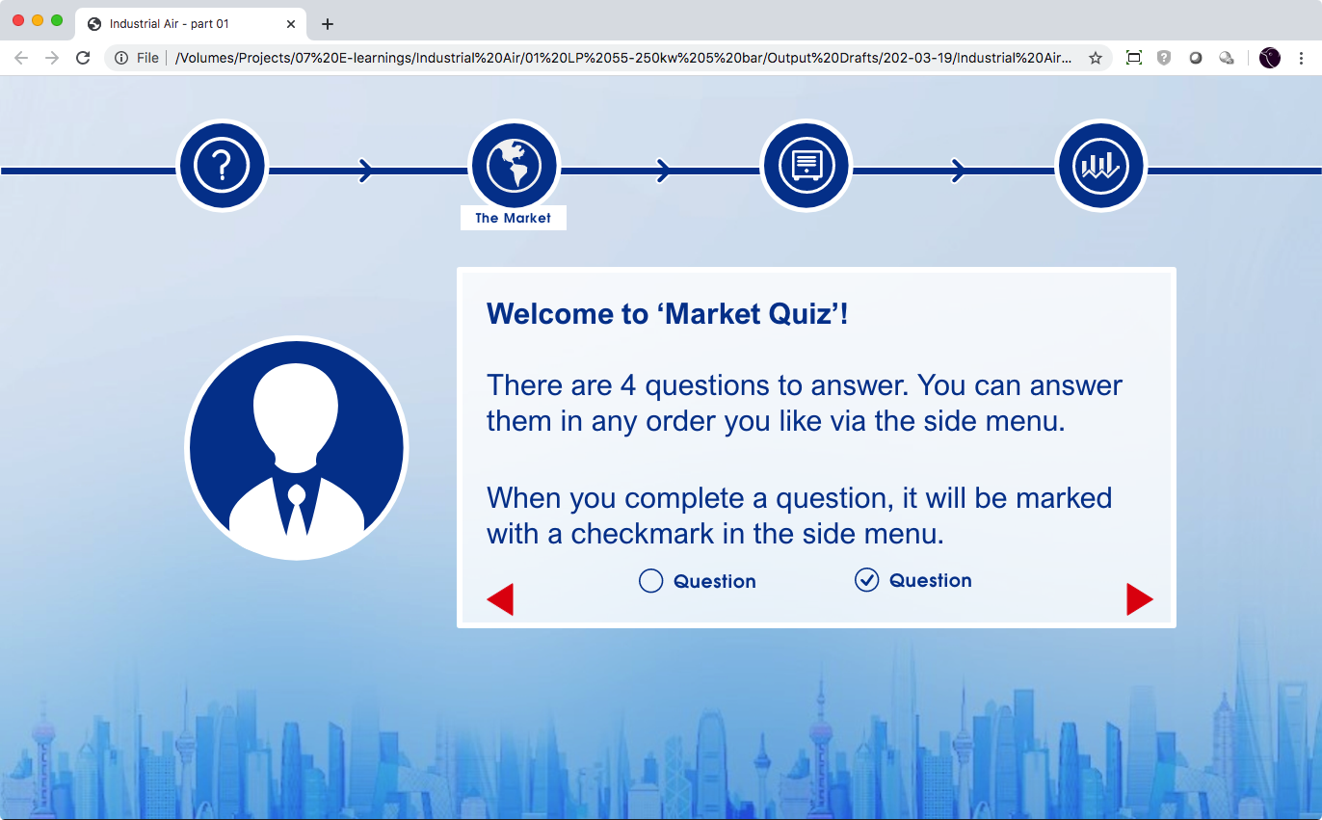
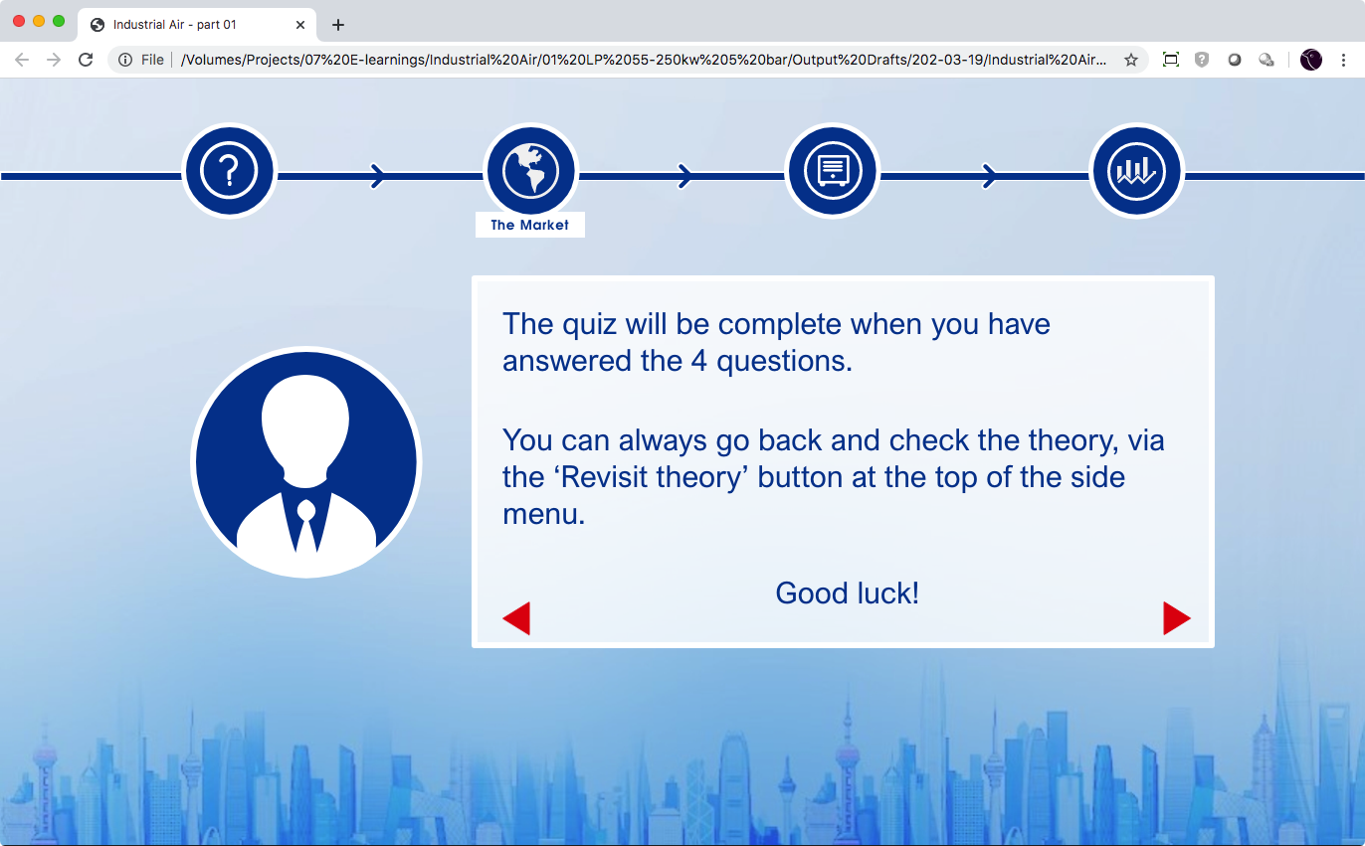
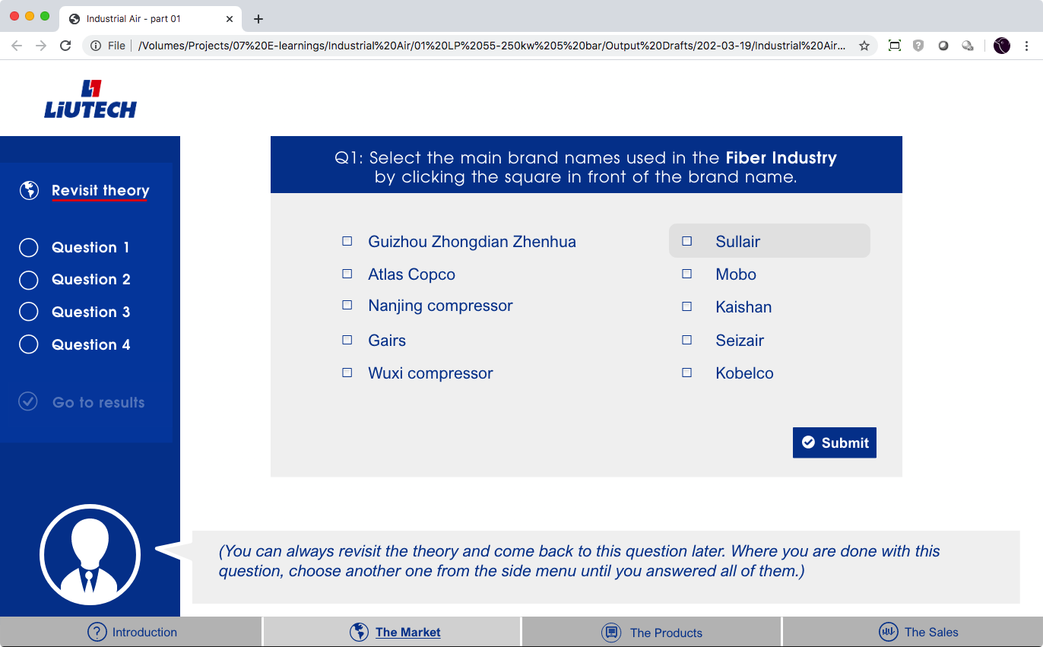

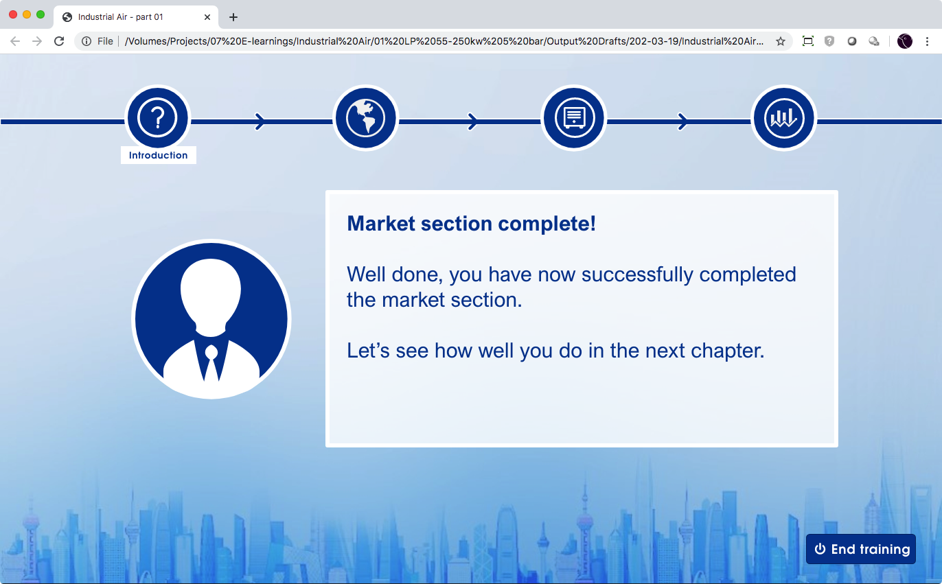
Round-up
At the end of the market chapter, a little test has to be taken.
During the test, the user can always go back to look up information.
LP 55-250kW 5 Bar – Structure E-learning

Slide 16
The products / sales
These two chapters are not yet worked out in detail (only in draft).
The principles will be similar.
All information from the original slides will be used (except for some “advanced” information – to be defined).
LP 55-250kW 5 Bar – Structure E-learning

Slide 17
supermus.be
to be continued

